Slide 1
Html AND css
Tables

Slide 2
tables
table = rectangular grid of rows and columns
Cell = intersection of a row and a column
Each cell can contain text, images, forms, table,....
Each cell is independent (e.g. text color is different everywhere)
Previously: tables were used for design => not usable for responsive design
Now: use CSS

Slide 3
Table Structure
<table>
<thead>
<tr> <th>heading</th>
</tr>
</thead>
<tbody>
<tr> <td>table cellen</td> </tr>
</tbody>
</table>
Optional!
Indicates beginning
and end of a row
Defines a cell styled
as heading
Defines a standard
cell

Slide 4

Table Structure
Keep the code readable:
use indentations!
<table>
<tr>
<td></td> <td></td> <td></td> <td></td>
</tr>
<tr>
<td></td> <td></td> <td></td> <td></td>
</tr>
<tr>
<td></td> <td></td> <td></td> <td></td>
</tr>
</table>

Slide 5
Joining Cells
colspan:
join cells horizontally
<td colspan="x">text</td>
x= the number of columns a cell should span
rowspan:
join cells vertically
<td rowspan="x">text</td>
x= number of rows a cell should span

Slide 6
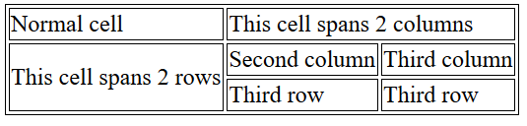
Joining Cells
<table>
<tr>
<td>Normal cell</td>
<td colspan="2">This cell spans 2 columns</td>
</tr>
<tr>
<td rowspan="2">This cell spans 2 rows</td>
<td>Second column</td>
<td>Third column</td>
</tr>
<tr>
<td>Third row</td>
<td>Third row</td>
</tr>
</table>
colspan="2"
rowspan="2"

Slide 7
Caption
add description to table:
<caption>text</caption>
This tag is placed directly under the <table> open tag
Only 1 caption per table

Slide 8
CSS for tables: align
horizontal alignment in cell
text-align : left
right
vertical alignment in cell
vertical-align : top
bottom
middle

Slide 9
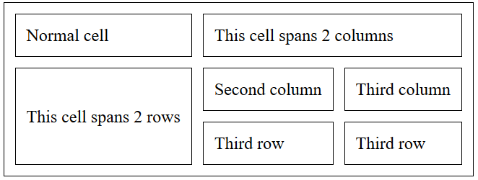
CSS for tables: spacing
padding in cell:
Defines space inside cells
border-spacing:
Defines space in between cells
table {
border:1px solid black;
border-spacing: 10px;
}
td {
border: 1px solid black;
padding: 10px;
}

Slide 10
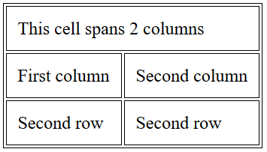
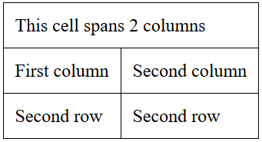
CSS for tables: borders
border-collapse:
Collapse borders of adjacent cells into one border or keep them separate
border-collapse: separate;
border-collapse: collapse;
remark: borders must be defined per cell,
border-collapse is a property of the whole table

Slide 11
CSS for tables: sizes
width and height
width: 100px -> in pixels
height: 50% -> in % of height parent element

Slide 12
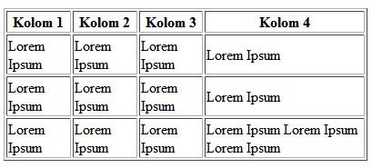
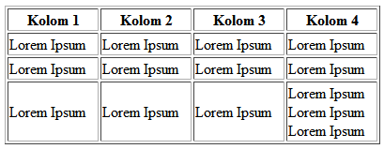
CSS for tables: sizes
table-layout: auto or fixed;
auto: column width is set by widest unbreakable content in the cells. Content dictates the layout.
fixed: column widths are divided equally across table, regardless of content inside cells
table-layout:auto; width: 400px;
table-layout:fixed; width: 400px;

Slide 13
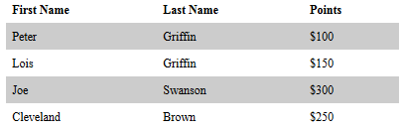
CSS for tables: colors
td,th {
color: white; -> text color
background-color: red; -> background of cell
}
tr:nth-child(even){
background-color: gray;
}

Slide 14
CSS for tables: other
caption-side: top OR bottom
Overview

Slide 15
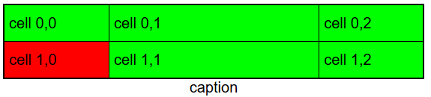
exercise
Create a table with following style:
the table width is 450px
the width of the 2nd column is half of the table width
solution

